Slide 1
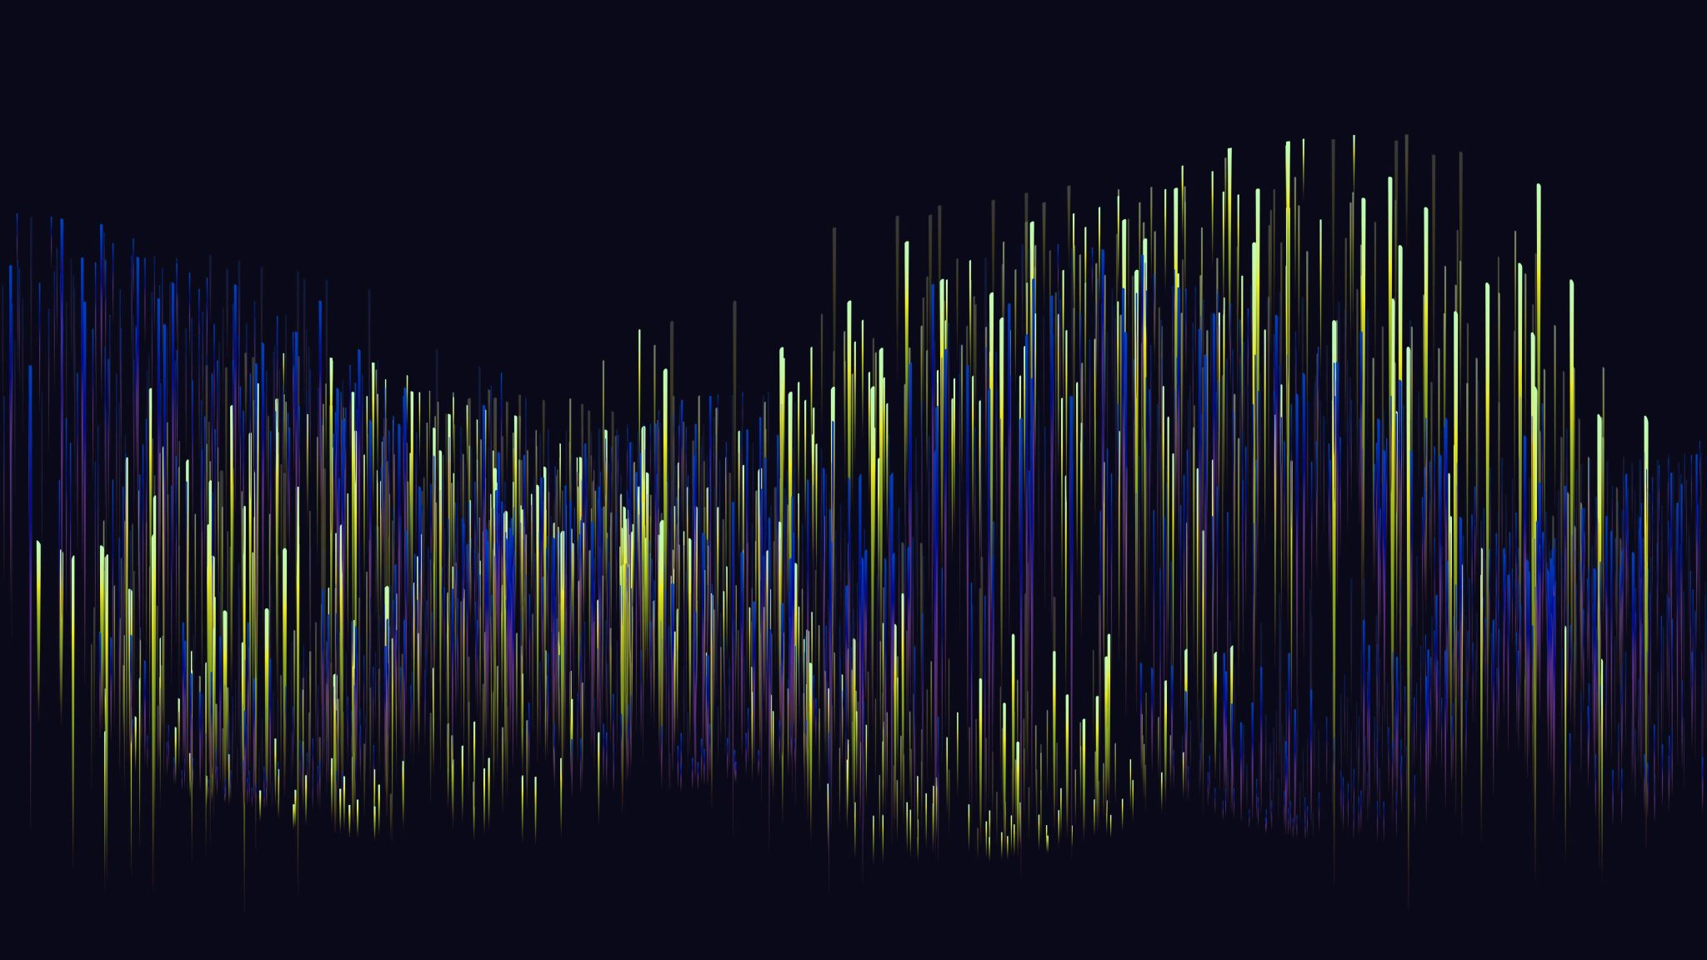
Debugging Progress

Slide 2
STEP1: Alignment
Surpassed because data set was already aligned

Slide 3
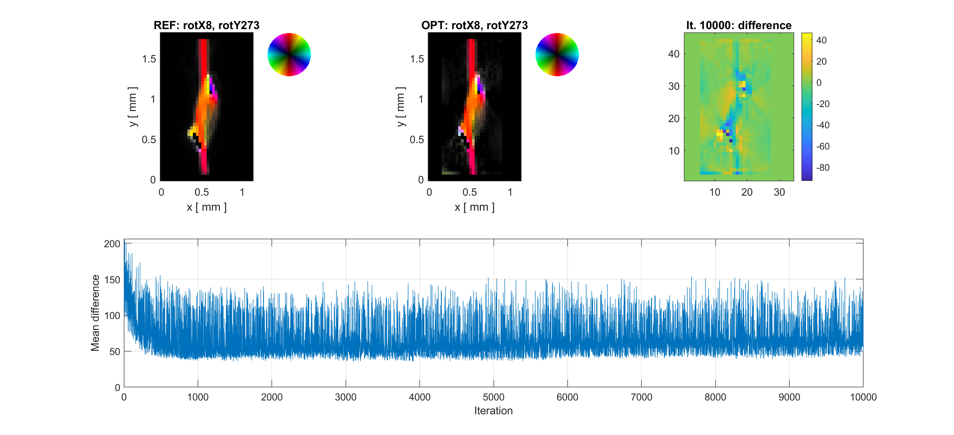
Step2: Optimization
Optimize using Iterative Reconstruction (IR), and use as initial guess

Slide 4
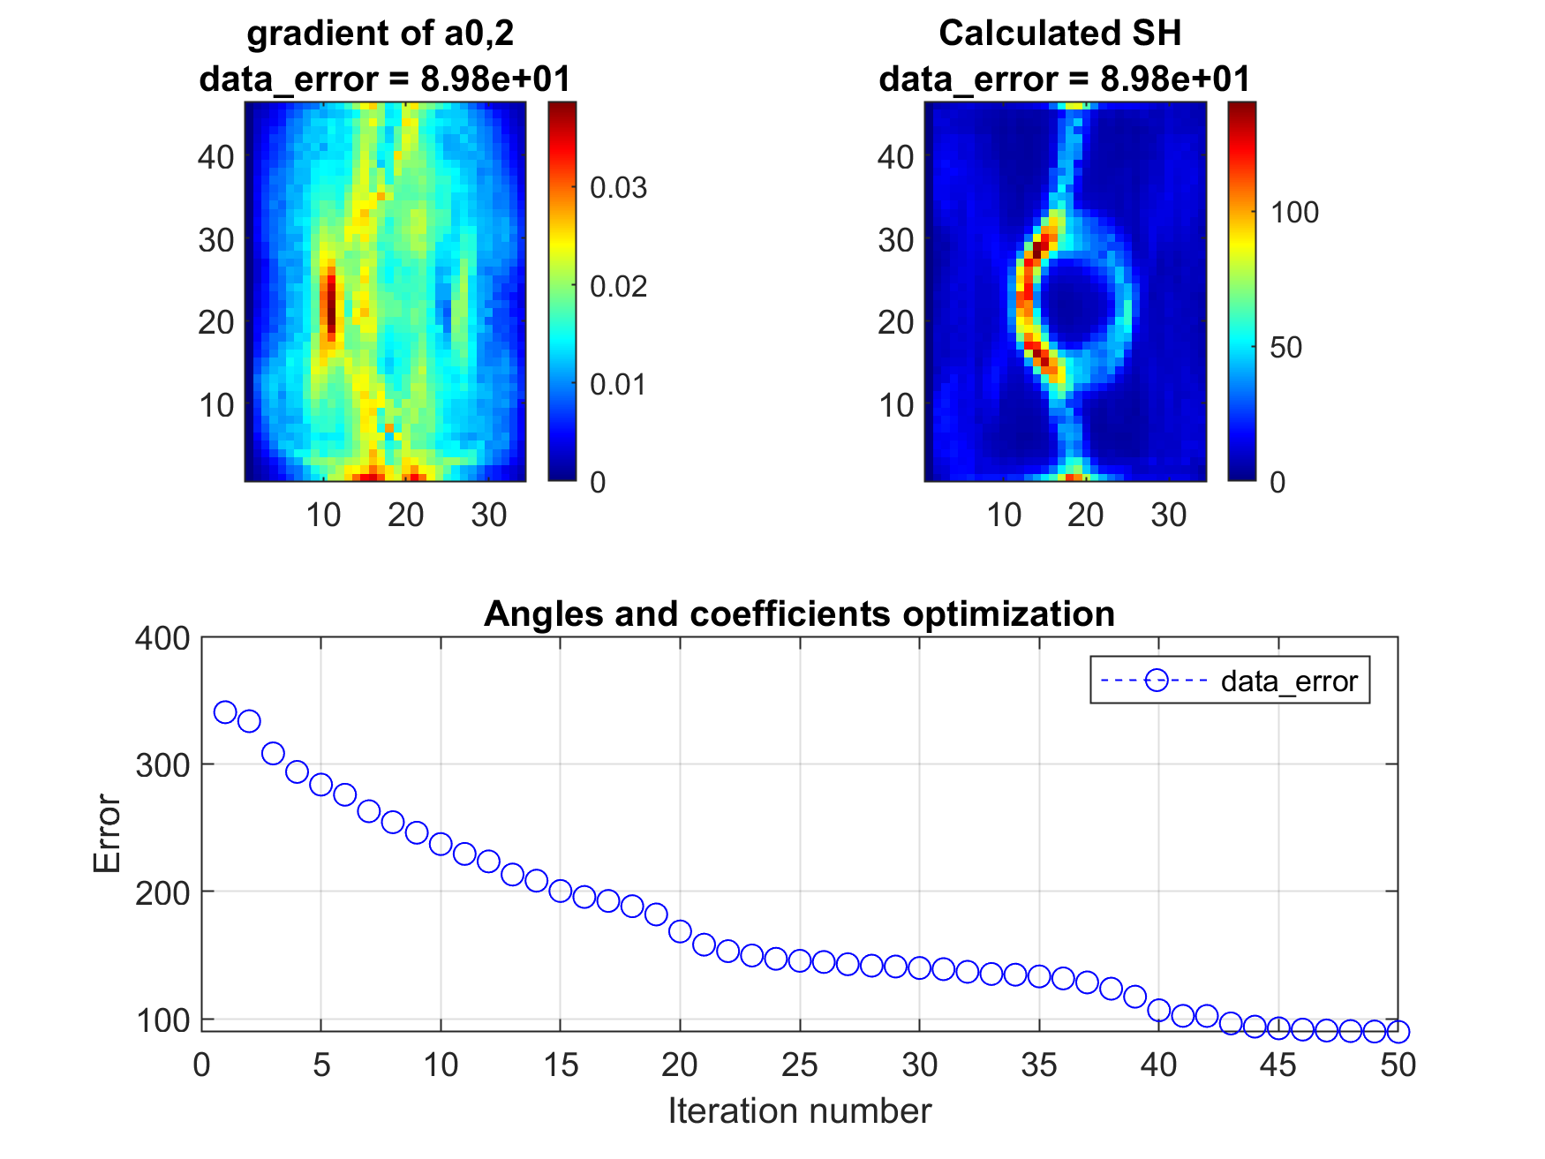
Step2: Optimization
Optimizing the spherical harmonics (SH) using IR as initial guess
Optimization procedure
Symmetric harmonics
Polar and azimuthal angle
Other coefficients
Everything together (See figure)

Slide 5
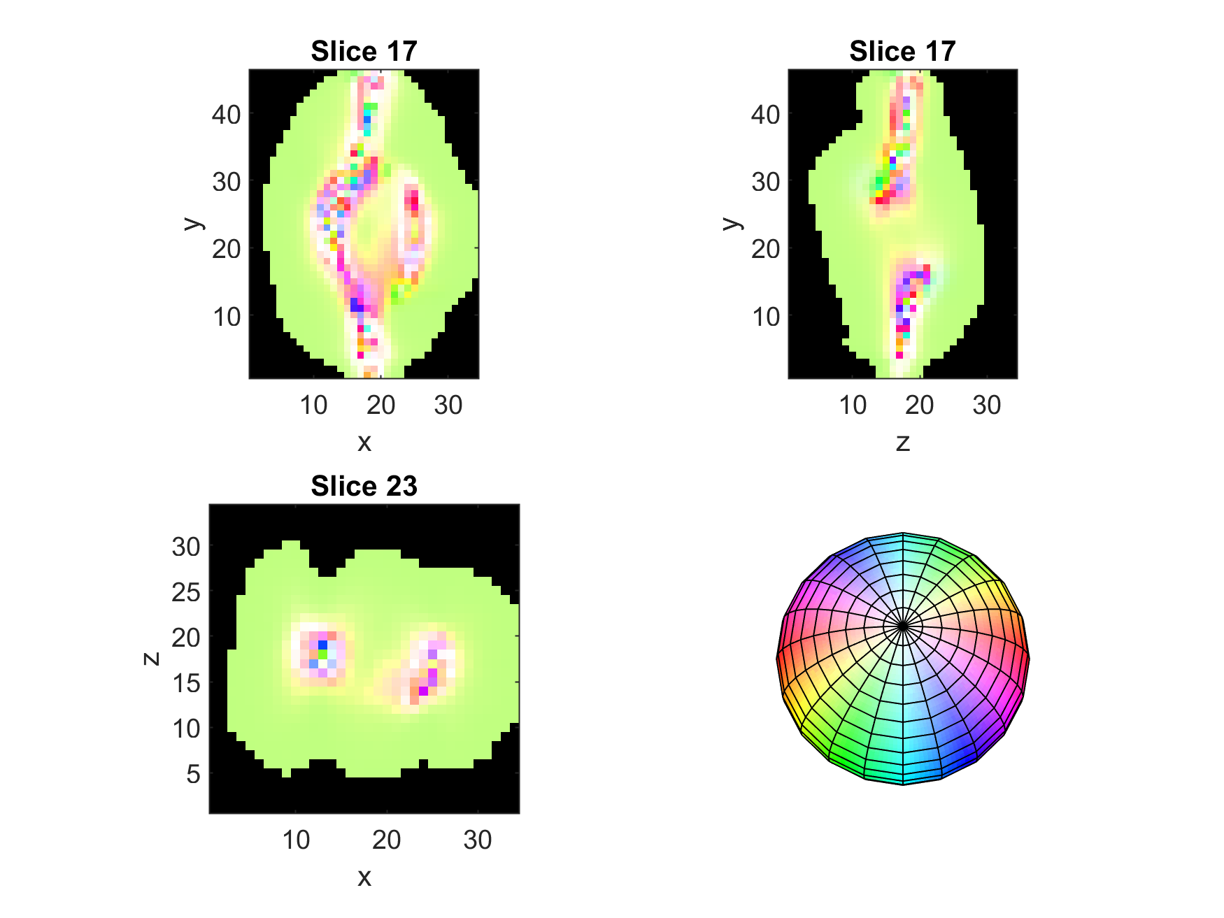
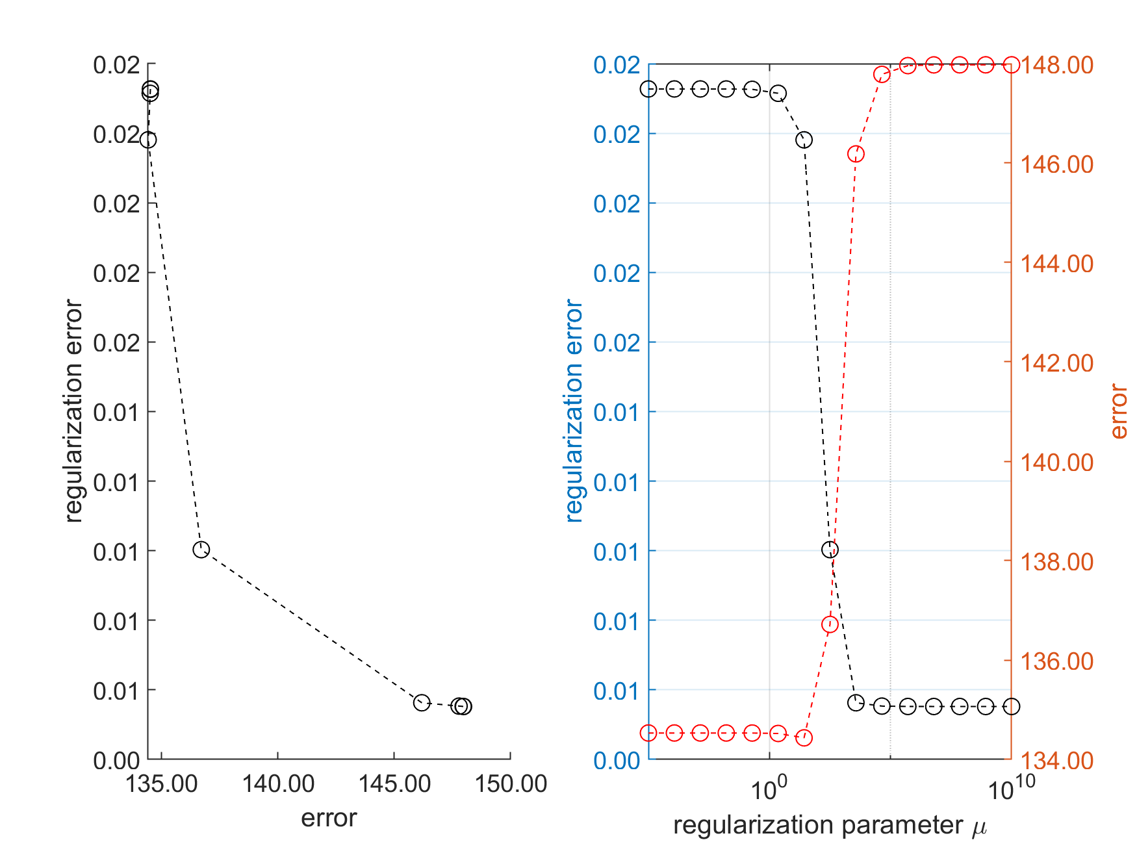
STep2: Optimization
Regularization

Slide 6
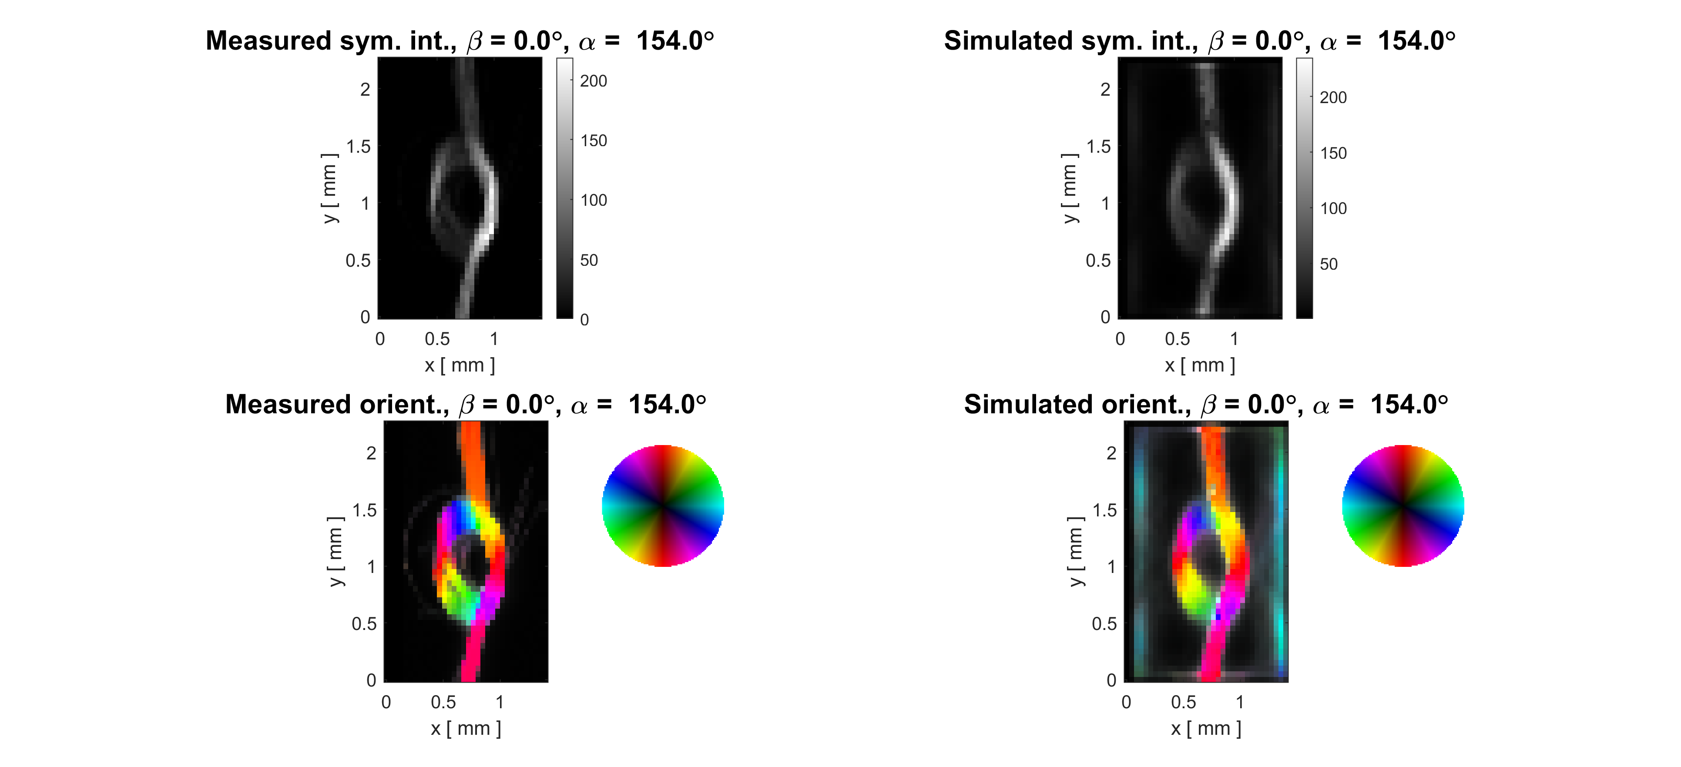
STEP3: Validation
Got corrected script from Kim Robert (Fredrik)
Compares measured and simulated intensities and orientations
Saves errors to results

Slide 7
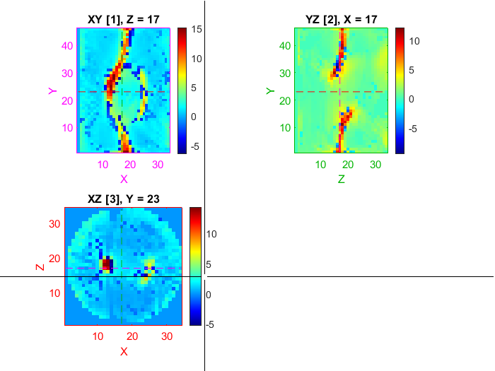
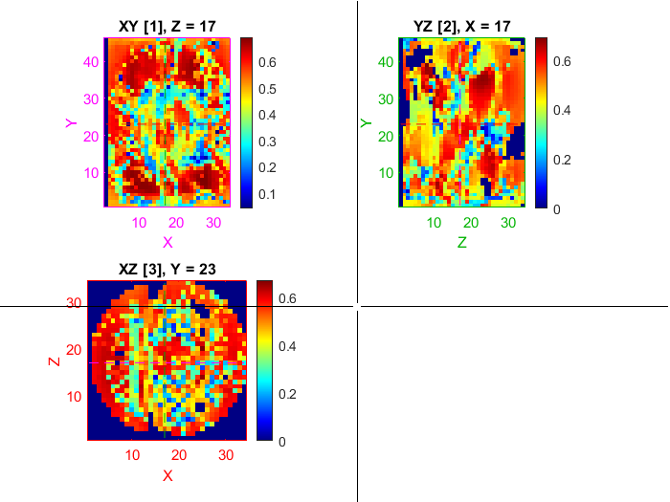
STep4: degree of orientation
Script attempted elementwise multiplication between coefficients and mask when they had different shapes
Reshaped based on intuition.

Slide 8
What have i done to achieve this
Fixed paths and folder system
Compiled scripts written in C#
Followed trail of function calls to understand the algorithm
Corrected bugs/errors

Slide 9
What has not been done?
Attempt at calculation with a proper number of iterations
Overview of all parameters: What should all parameters be set to?

Slide 10
Continuation
Meeting with Fredrik
Accurately locate where to change from CGD to AD (Know the file, not the section)
Simple implementation of AD compared to symbolic differentiation (As done in mentioned survey)
Do the changes. But first do a proper run-through.
Begin methods and theory
Prepare proper list of bugs.

